Slide 1


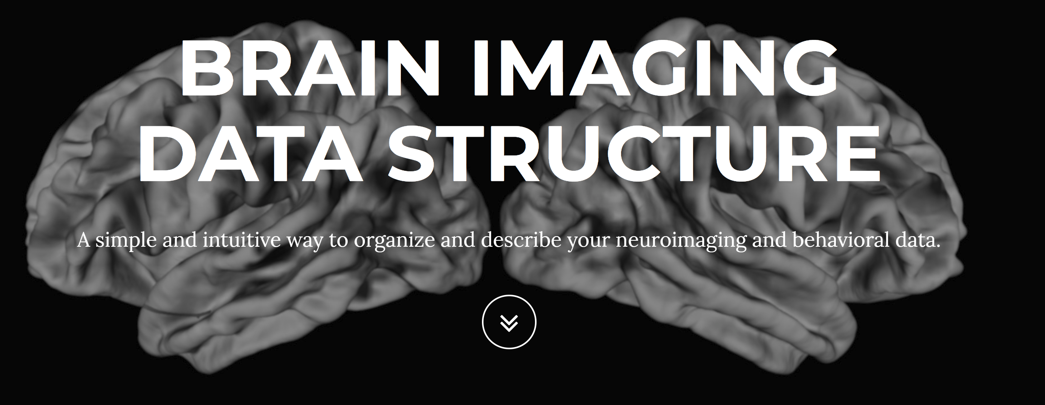

The Reproduceable Toolchain in fMRI analysis
Reporter: Xiaokai Xia

Slide 2
Reference
Gorgolewski, K., Burns, C. D., Madison, C., Clark, D., Halchenko, Y. O., Waskom, M. L., & Ghosh, S. S. (2011). Nipype: a flexible, lightweight and extensible neuroimaging data processing framework in python. Frontiers in neuroinformatics, 5, 13.
Gorgolewski, K. J., Auer, T., Calhoun, V. D., Craddock, R. C., Das, S., Duff, E. P., ... & Handwerker, D. A. (2016). The brain imaging data structure, a format for organizing and describing outputs of neuroimaging experiments. Nature Scientific Data, 3, 160044.
Esteban, O., Markiewicz, C. J., Blair, R. W., Moodie, C. A., Isik, A. I., Erramuzpe, A., ... & Oya, H. (2019). FMRIPrep: a robust preprocessing pipeline for functional MRI. Nature methods, 16(1), 111.
Power J.D. (2017). A simple but useful way to assess fMRI scan qualities. NeuroImage. doi: 10.1016/j.neuroimage.2016.08.009
Boettiger, C. (2015). An introduction to Docker for reproducible research. ACM SIGOPS Operating Systems Review, 49(1), 71-79.

Slide 3
Resources
https://nipy.org/
https://bids.neuroimaging.io/
https://www.docker.com/
https://fmriprep.readthedocs.io/
https://github.com/dddd1007/NfMRIx

Slide 4
Challenges of in-house research
Computational resources: the need to handle large data volumes and long computation times;
Validation: a need for new, well-validated analysis methods;
Reproducibility: due to the workflow complexity, it can be difficult for others (or yourself in a few months time) to reproduce the analysis.
Unité de Neurosciences, Information et Complexité (UNIC), Centre National de la Recherche Scientifique, 91198 Gif sur Yvette, France. http://andrewdavison.info

Slide 5


Slide 6
Describe in papers
Hidden in Code

Slide 7
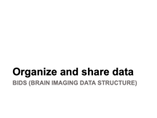
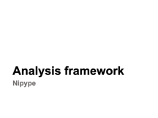
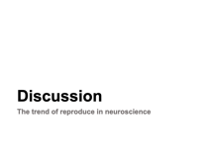
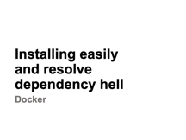
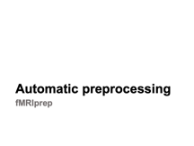
Abstract

Slide 8
Analysis framework
Nipype

Slide 9
Framework
A standard way to build applications
A universal, reusable develop environment
Easy to achieve some functions or features

Slide 10
Issues created by heterogeneous tools
No uniform access for each tools
Fragmentation of algorithm
Personnel turnover limits methodological continuity
Wasting time on training new person
Hard to comparative algorithm
Not conducive to dissemination the algorithm
Neuroimaging software packages do not address computational efficiency
Methods sections in journal articles are inadequate for reproducing results

Slide 11
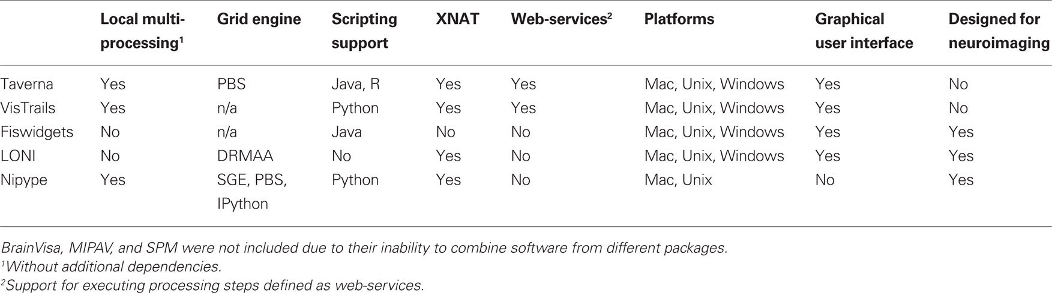
Current Solution

Slide 12
Solution provided by nipype
Providing Interfaces to existing all software
uniform usage semantics
Facilitating interaction between these packages
rapid compare algorithms
reduces the learning curve
Using multi-core or other computational resource without additional scripting

Slide 13
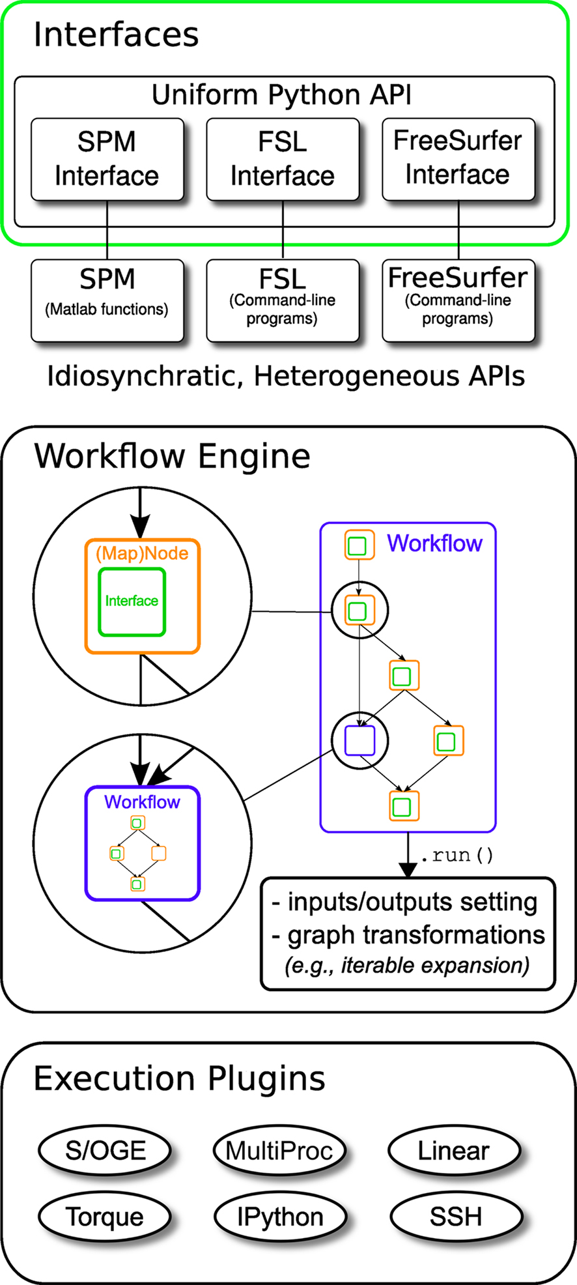
Implementation Details
Interfaces to external tools
provide a unified way for setting inputs, executing, and retrieving outputs
Workflow engine
allows creating analysis pipelines by connecting inputs and outputs of interfaces as a directed acyclic graph (DAG)
Plug-ins
execute workflows either locally or in a distributed processing environment

Slide 14
Interface
Provide a uniform mechanism for accessing different analysis tools
Interfaces can be used directly as a Python object
Definition consists of
input parameters
outputs and their types
how to execute the underlying software
a mapping defines the outputs

Slide 15
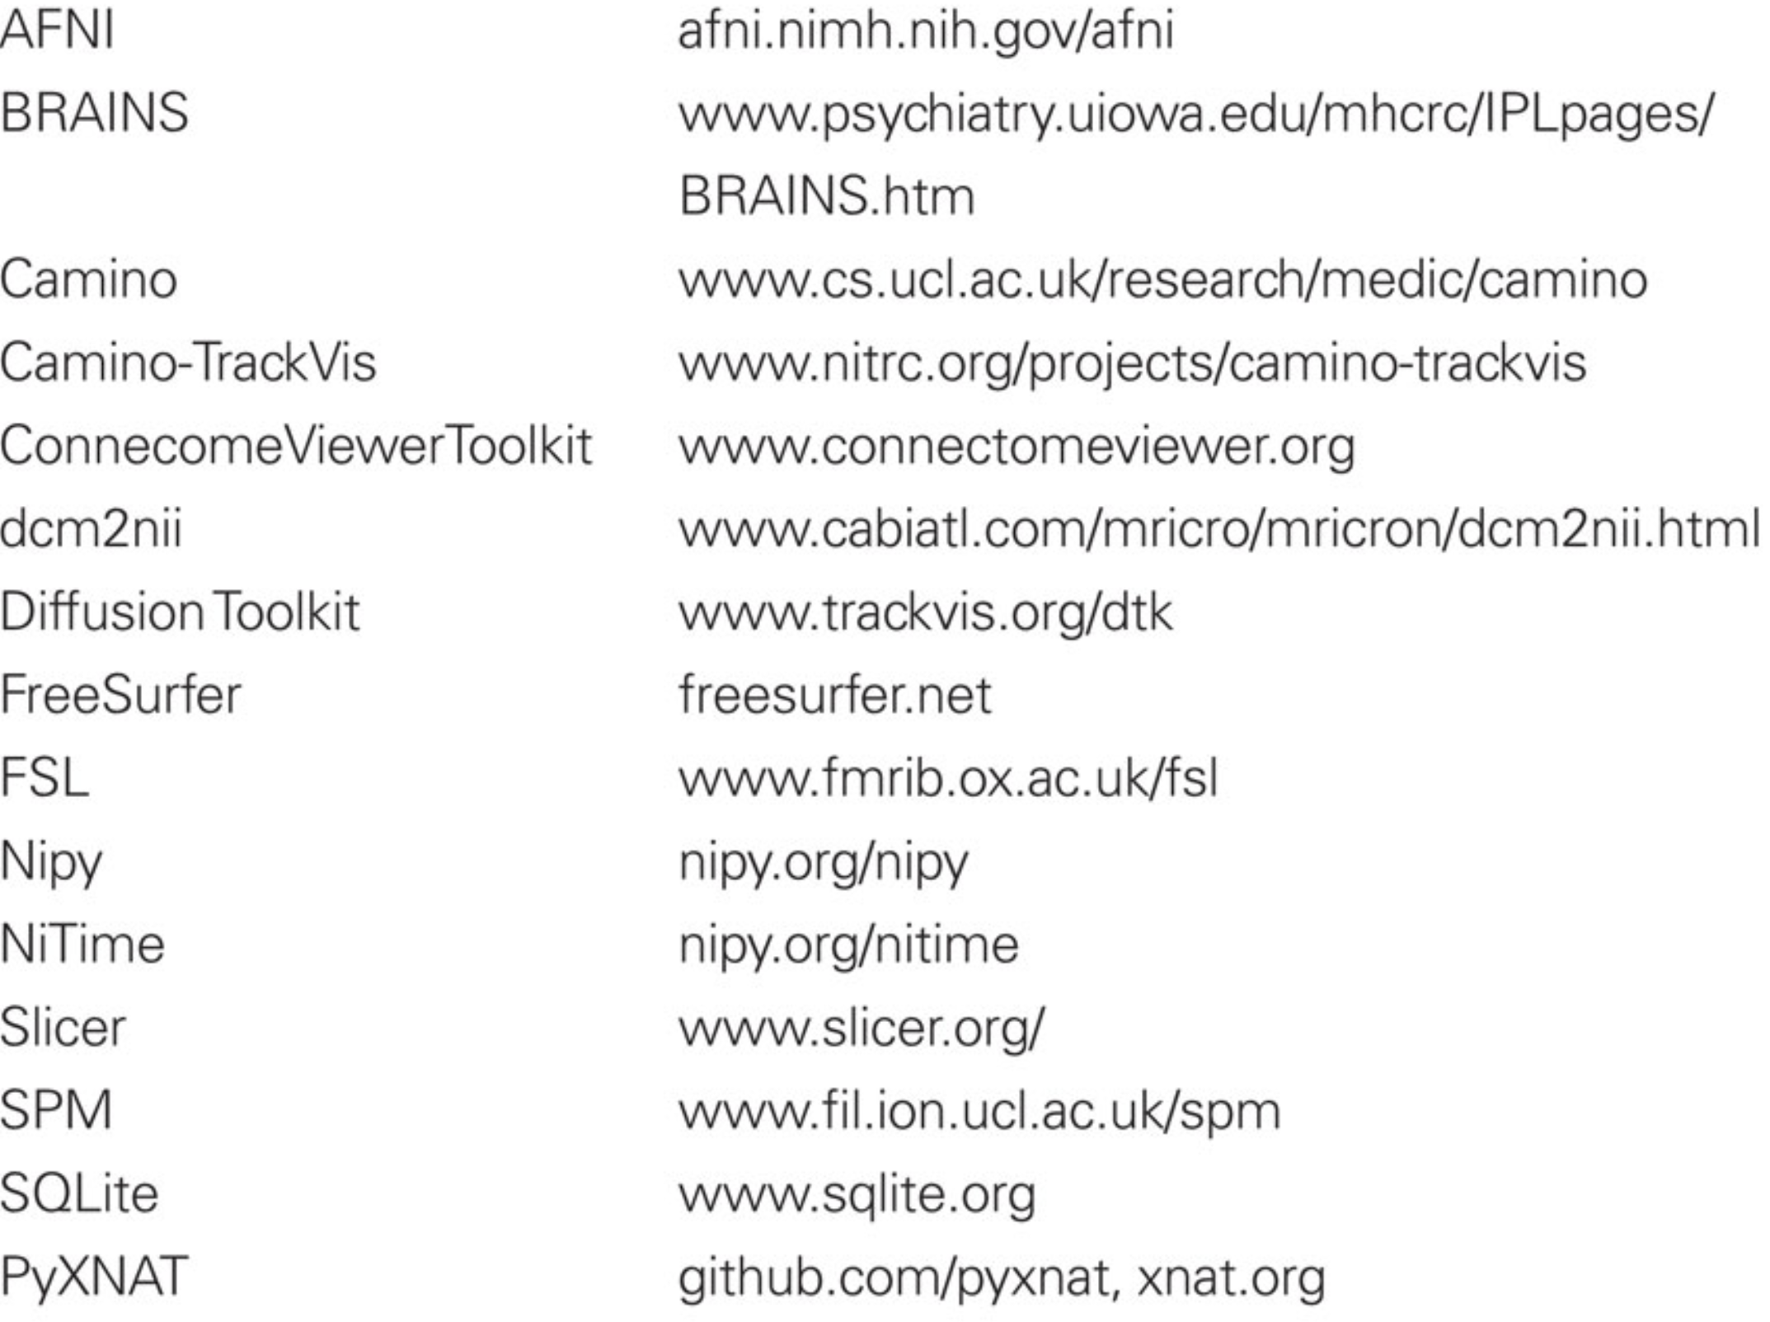
Support Software

Slide 16
Node / MapNode
Interfaces encapsulated in either Node or MapNode objects
Adv.
Isolate
Distribute

Slide 17
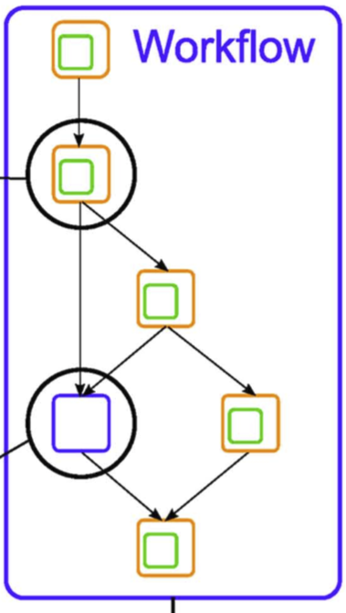
Workflow
Captures the processing stages and the dependencies between these processes
Show it as a DAG graph
Adv.
Provides a directly description of the processing steps and how data flows between Interfaces
Easy to modify the workflow

Slide 18
Organize and share data
BIDS (BRAIN IMAGING DATA STRUCTURE)

Slide 19
DICOM → Nifti
DICOM (Digital Imaging and Communications in Medicine)
DICOM groups information into data sets
Consists of a number of attributes
Nifti (Neuroimaging Informatics Technology Initiative)
Enhance the utility of informatics tools related to neuroimaging
Affine coordinate definitions relating voxel index (i,j,k) to spatial location (x,y,z)
Store vector-valued datasets over 1-4 dimensional domains

Slide 20
Issues
Tens of thousands subjects are scanned for research purposes each year
Each study results in complex data involving many files in different formats
There has been no consensus about how to organize and share these data
Deduce
misunderstanding and time wasted on rearranging data
rewriting scripts that expect organization

Slide 21
Benefits
Minimized curation
within a laboratory over time,
between labs facilitating
between public databases
Misleading reduction
Optimized usage of data analysis software
Development of automated tools

Slide 22
Previous solution
XCEDE
Not all analysis software can read XML
OpenfMRI
No explicit support for a number of important data types (physiological recordings, DWI, or field maps)

Slide 23
Development idea
Based on common laboratory practices
Encoding the purpose of a file in its filename
widely recognized file formats
NIfTI
JSON
TSV
Consultation with leading scientists and public calls
Resulting specification is based on simple file formats (often text-based) and folder structures

Slide 24
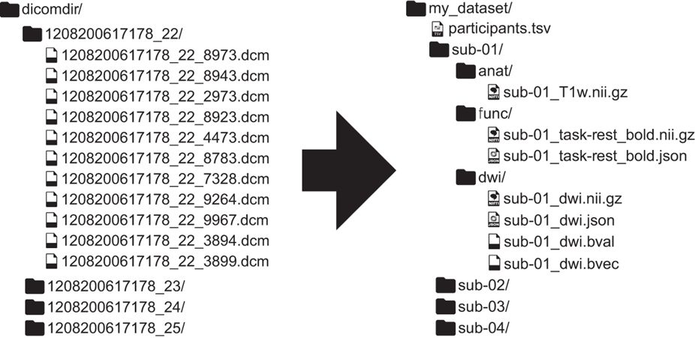
Result

Slide 25
Result
Filenames
formed with a series of key-values
end with a file type
Metadata file
Defined at one of four levels (MRI acquisition, session, subject, or dataset)
Additional files can include to the existing folder structure
Derivatives of the raw data keep separate from the raw data

Slide 26
File formats
Imaging files —— NIfTI file format
Provide additional meta information in a sidecar JSON file
Tabular files —— Tab-delimited value (TSV) files
Key/value files —— Json file

Slide 27
Metadata request
Minimal
Anatomical scans
specifying the type
Functional scans
task name
repetition time (in seconds)
timing and duration of all events
Diffusion weighted imaging
b-values
diffusion gradient tables
Recommend
slice timing
phase encoding direction
effective echo spacing
echo time

Slide 28
Create BIDS data
Step1: Convert DICOM files to NIfTI
Step2: Create folder structure, rename and copy NIfTI files
Step 3: Add remaining data
events.tsv(onset, duration)
Step 4: Add missing metadata
the name of each fMRI task
Step 5: Validate the dataset

Slide 29
Tools
Converters
AFNI BIDS-tools
BIDS2ISATab
BIDSto3col
BIDS2NDA
bidskit
Data2Bids
Dcm2Bids
DCM2NIIx
DICM2NII
HeuDiConv
OpenfMRI2BIDS
ReproIn (HeuDiConv-based turnkey solution)
bids2xar (for XNAT import)
XNAT2BIDS
Horos (Osirix) export plugin
BIDS2NIDM
BIDScoin
MNE-BIDS (MEG/EEG/iEEG)
EEGLAB with plugin (MEG/EEG analysis package)

Slide 30
Tools
Graphically convert raw KIT and Elekta MEG data to BIDS format
Other Tools
Automatic Analysis (fMRI processing toolbox)
BIDSHandler (Python module allowing complete manipulation of BIDS data)
Brainstorm (MEG/EEG analysis package)
C-PAC (Configurable Pipeline for the Analysing Connectomes)
FMRIPREP (preprocessing workflow)
OpenNeuro (repository)
PyBIDS (Python module to harmonize access and manipulation)
Quality Assessment
MRIQC
QAP

Slide 31
Automatic preprocessing
fMRIprep

Slide 32
Issues
Preprocessing
reduce sources of false positive errors
without inducing false negative error
Input variety data need different method
Different pipeline have different method

Slide 33
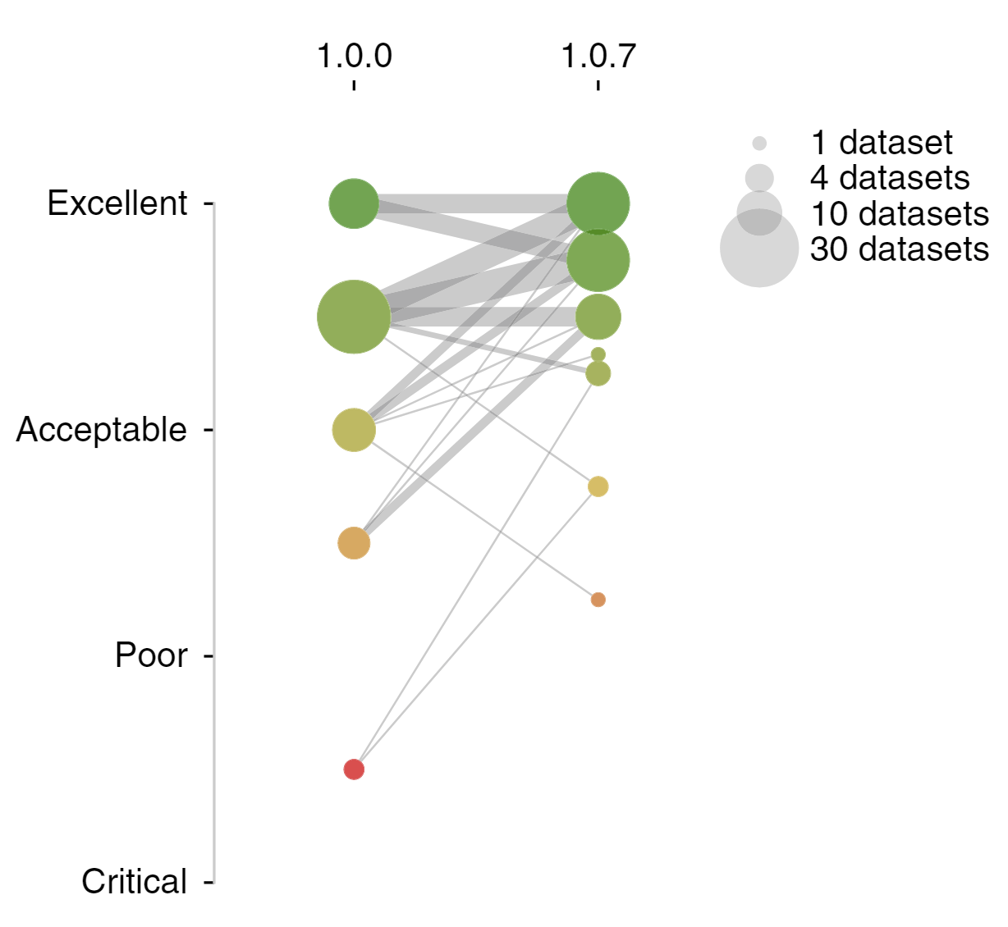
Two-stage validation framework

Slide 34
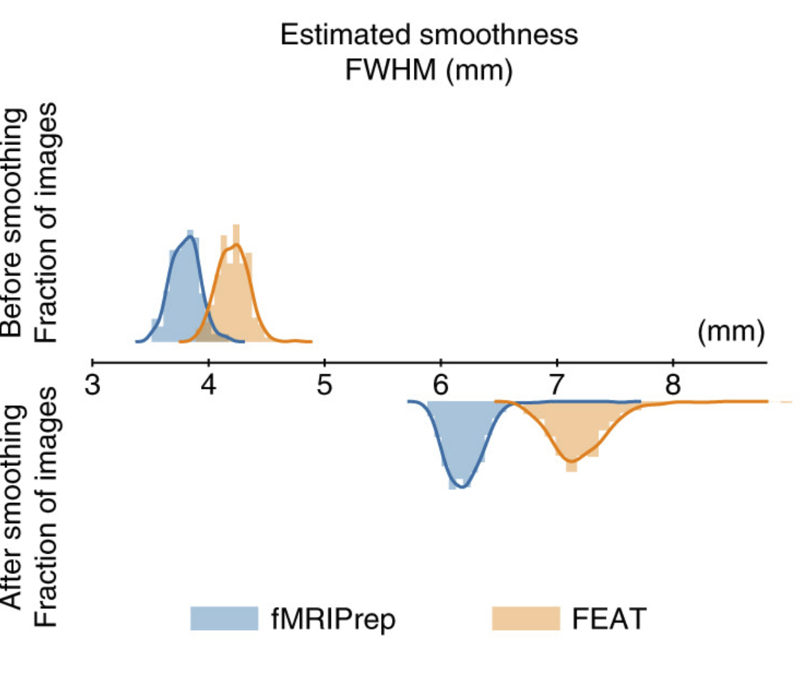
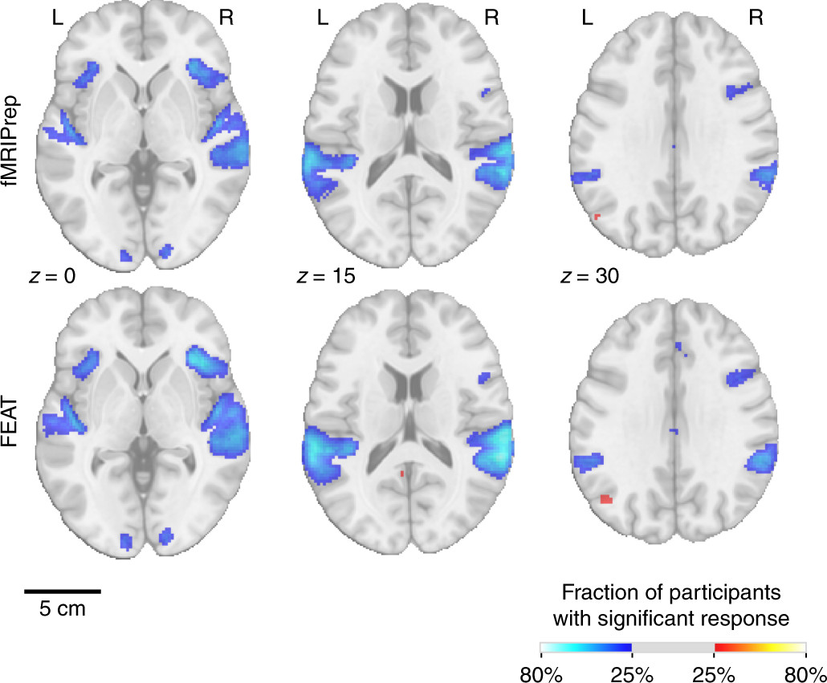

Slide 35
Preprocessing step
Head-motion correction
Susceptibility distortion correction
Field map
T1w/T2w anatomically-correct
Surface registration
Slice-timing correction
Intra-subject registration
Spatial normalization
Surface sampling
Subspace projection denoising (ICA/PCA)

Slide 36
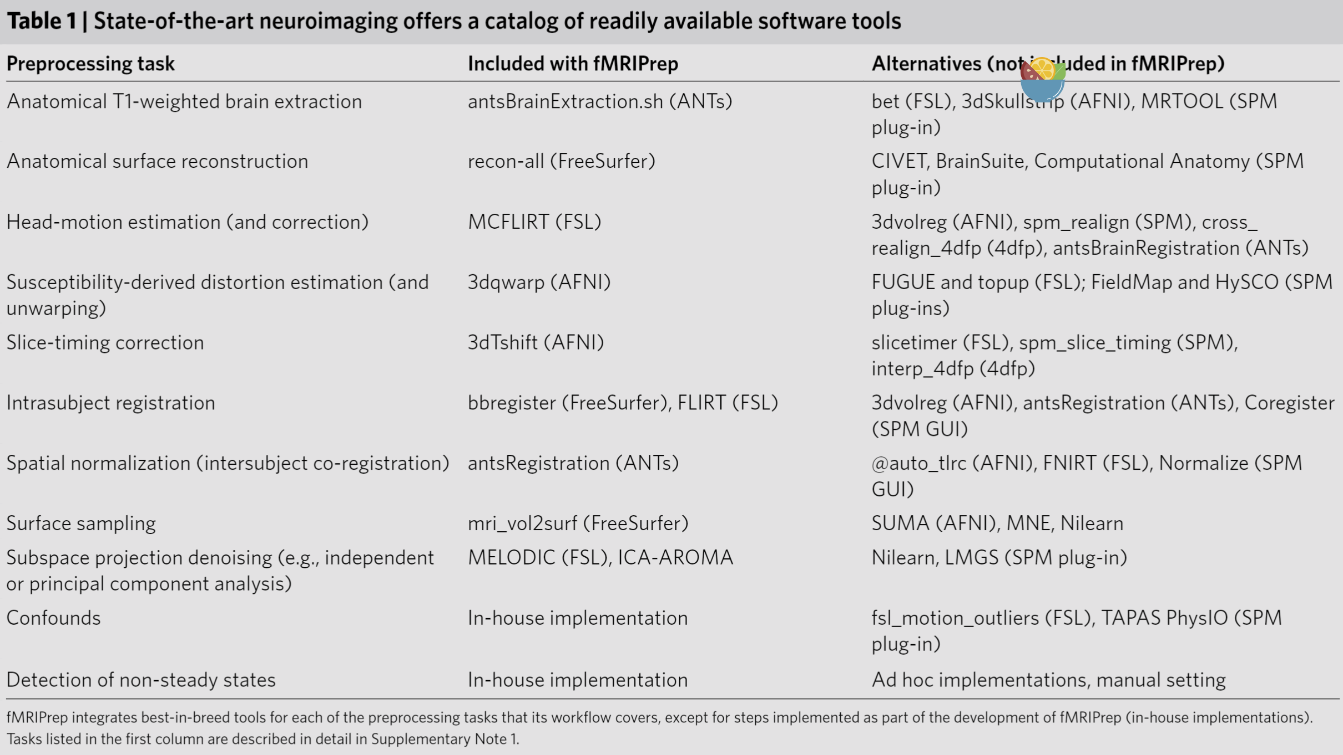
Tools invoked in fMRIprep

Slide 37
Workflow
T1w/T2w preprocessing
Brain extraction, brain tissue segmentation and spatial normalization
Longitudinal processing
Surface preprocessing
Refinement of the brain mask
BOLD preprocessing
BOLD reference image estimation
Head-motion estimation
Slice time correction
Susceptibility Distortion Correction (SDC)
Pre-processed BOLD in native space
EPI to T1w registration
EPI to MNI transformation
EPI sampled to FreeSurfer surfaces

Slide 38
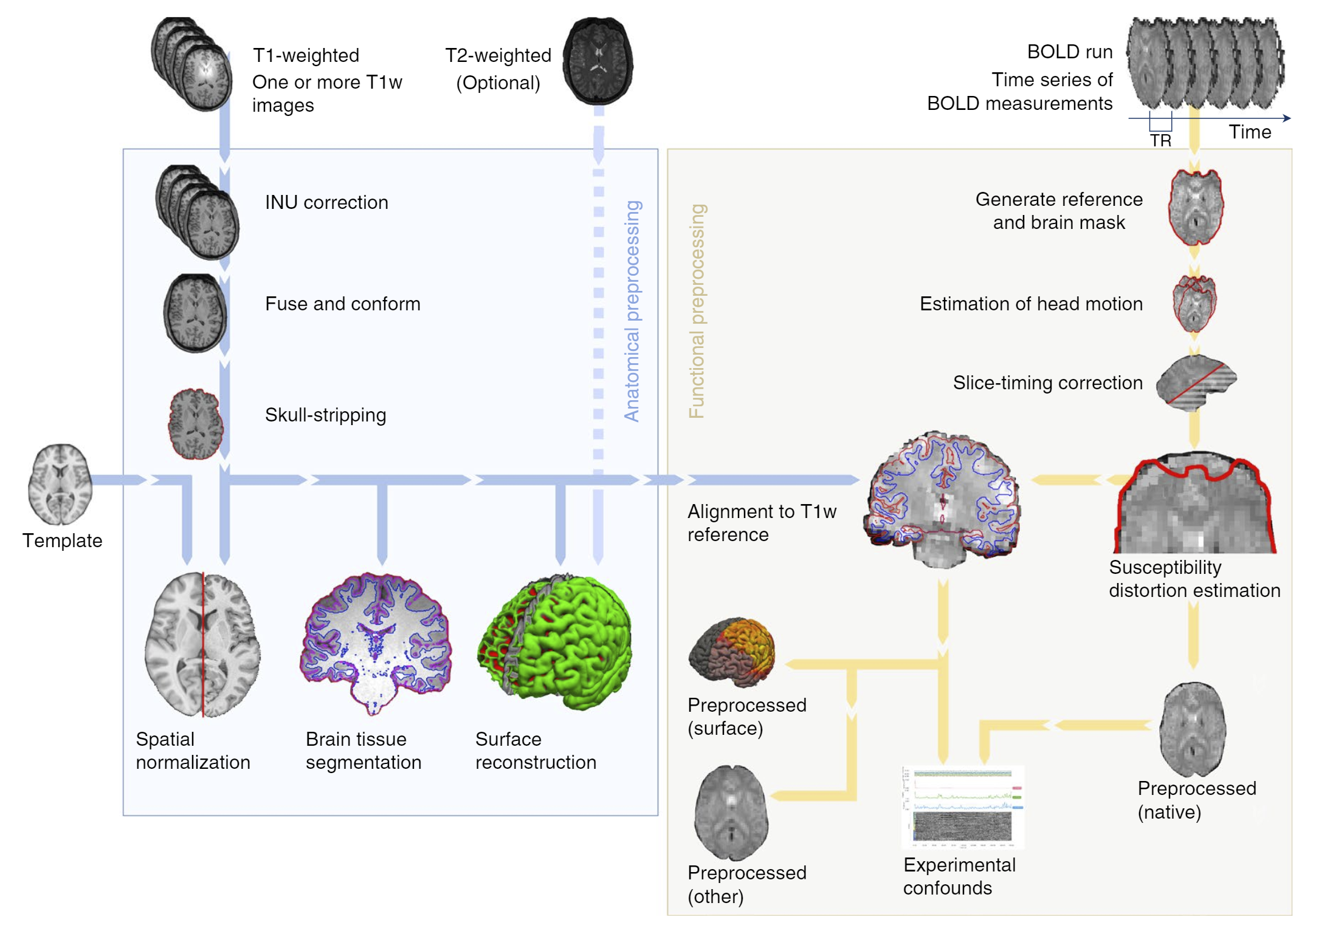
Workflow

Slide 39
Output of fMRIprep
preprocessed time series
derived from the original data
apply retrospective signal corrections
spatiotemporal filtering
resampling onto a target space
experimental confounds
motion parameters
framewise displacement
global signals
Visual Report

Slide 40
Adv. Of fMRIprep
Input BIDS and make a adaptive workflow
Easy read and transparency visual report Demo
As an analysis-agnostic method to exclude limitation such as coordinate space
HCP Pipelines supports surface-based analyses
C-PAC and FEAT are volume-based only
Yields high-quality results (Results)
Prevents loss of spatial accuracy via smoothing (Results)
Notes:
HCP 人类连接组计划

Slide 41
DVARS
DVARS
D referring to temporal derivative of time courses
VARS referring to RMS variance over voxels
Index the rate of change of BOLD signal across the entire brain at each frame of data
DVARS is thus a measure of how much the intensity of a brain image changes in comparison to the previous timepoint
Power, J. D., Schlaggar, B. L., Lessov-Schlaggar, C. N., & Petersen, S. E. (2013). Evidence for hubs in human functional brain networks. Neuron, 79(4), 798–813. doi:10.1016/j.neuron.2013.07.035
Notes:
UCLA ： 变化在0.4% 之内
FSL：变化在0.5%以内

Slide 42
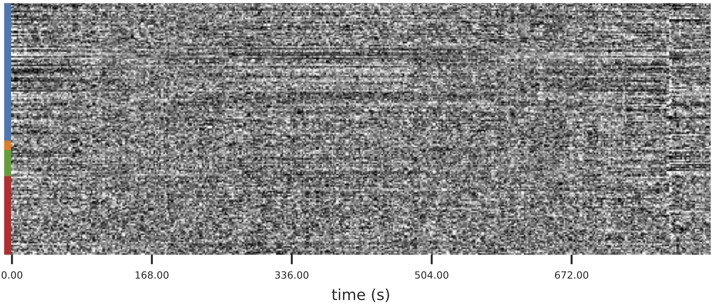
Carpet Plot

Slide 43
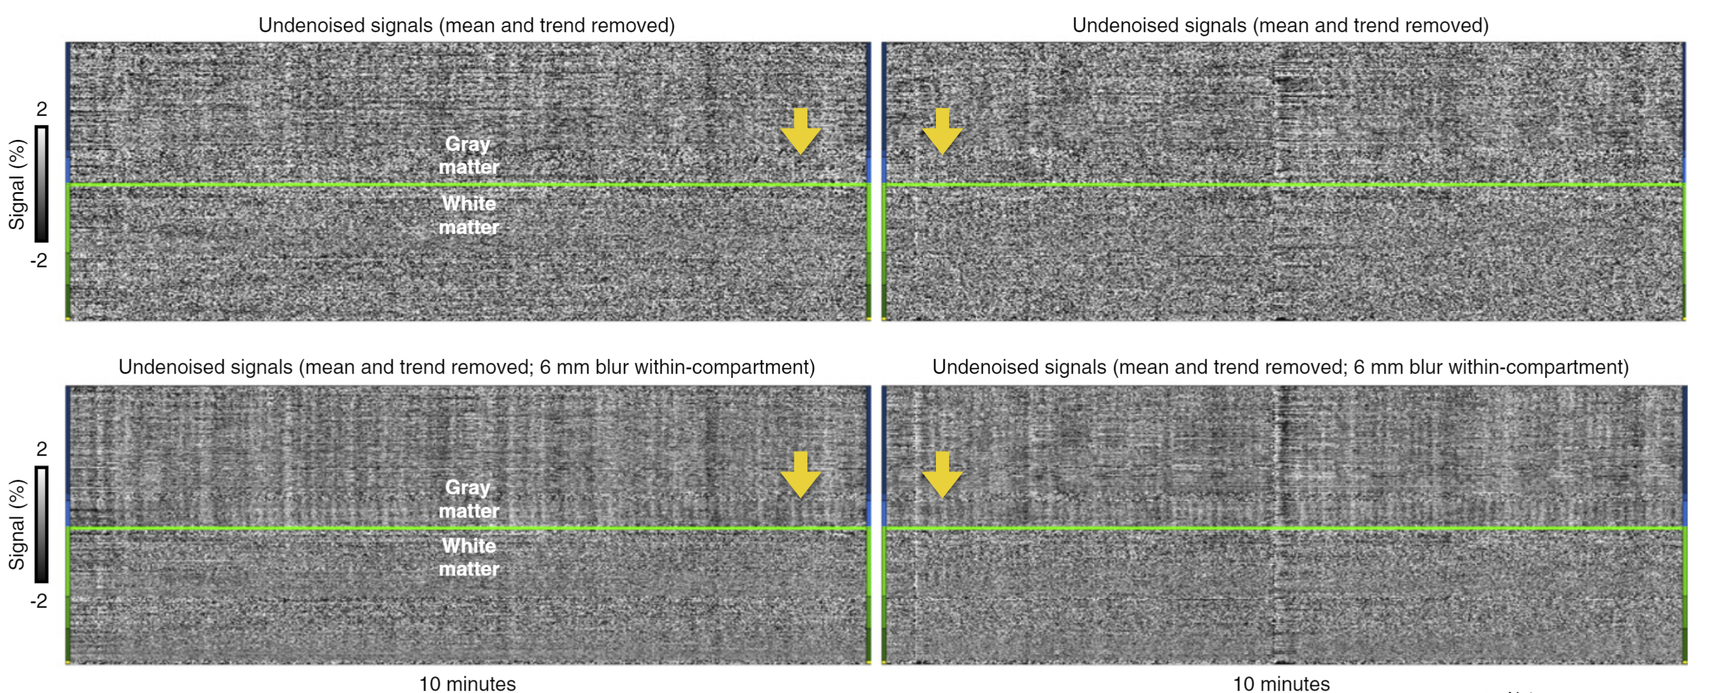
Recognizing noise in fMRI
Thermal noise
Has no spatial or temporal structure
Blur can reduce the effect
Notes:
Blur 以后可以看到头动
可以看到周期性的变化，应该是呼吸
配对性的头动通常与大的呼吸（哈切，深呼吸）有关

Slide 44
Recognizing noise in fMRI
Head motion
Whole brain activities
Paired or not paired / regular or not regular
Notes:
Blur 以后可以看到头动
可以看到周期性的变化，应该是呼吸
配对性的头动通常与大的呼吸（哈切，深呼吸）有关

Slide 45
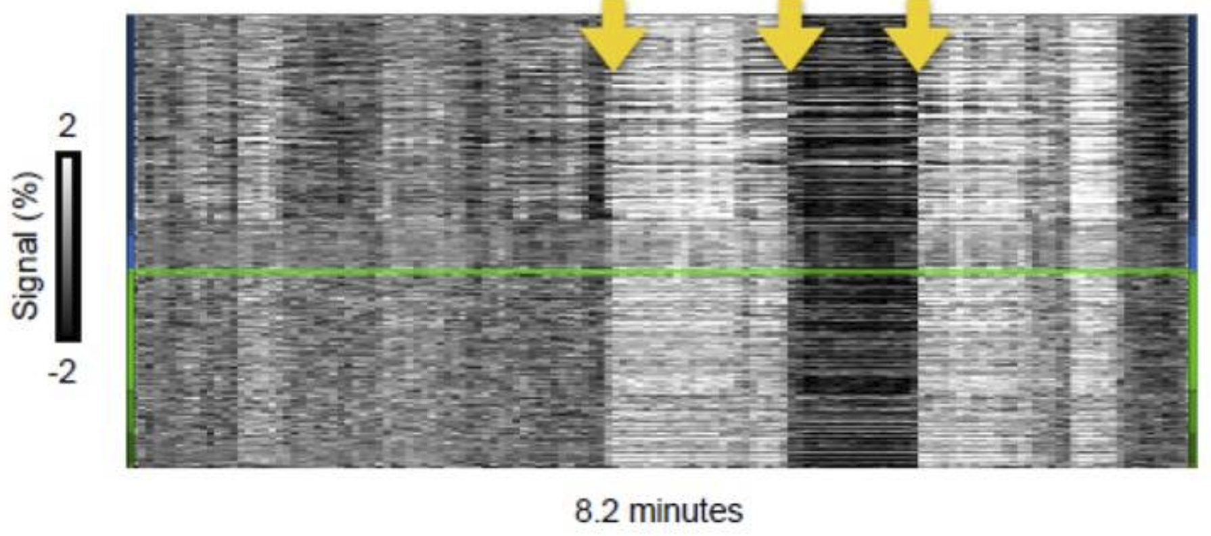
Recognizing noise in fMRI
Hardware artifacts
cans look unremarkable
high quality with respect to motion and physiological records
Notes:
Blur 以后可以看到头动
可以看到周期性的变化，应该是呼吸
配对性的头动通常与大的呼吸（哈切，深呼吸）有关

Slide 46
Installing easily and resolve dependency hell
Docker

Slide 47
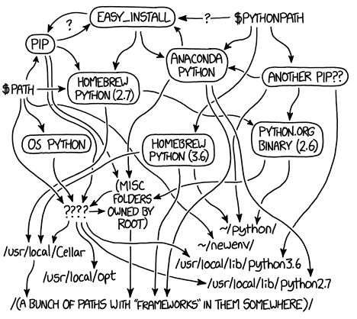
Dependency hell
Some software which have dependencies on specific versions of other software packages

Slide 48
Container
A standard unit of software that packages up
Code
Dependencies
Adv.
Standard
Standalone
Secure
Easy
Everywhere
Lightweight

Slide 49
Images of fMRI
Neurodocker
Nipype
fmriprep
bids/validator
afni / fsl / freesurfer
…

Slide 50
Discussion
The trend of reproduce in neuroscience

Slide 51
Discussion
Computational resources
Validation
Reproducible
Flexible

